Slide 1

Nexview Consulting
100 Day Plan for Supply Chain Executives in New Roles
A guideline plan with examples to build consensus for structured change

Slide 2
Congratulations on your new role, we hope this guide can help you
Our initial comments for your consideration
100 Day Plan and Milestones
Example communication and best practice items

Slide 3
This can help you organize, plan, and jumpstart (or check) your efforts
Congratulations on your new role!
Perhaps these contents reinforce your plans, or add a couple things you weren’t thinking of, there are many examples
As we know when in a new role, it’s important to make a fast, visible impact
Visibility and communication
Commitment – You need to dive off the board, dipping your toe will only work for a very short time at your level; doing the “regular job” is not enough right now
Action – Needed especially on quick wins; for longer items, even only a couple initial improvements will have impact
The plan is geared towards those who have joined new companies
If you’ve not changed companies, but have just been promoted, you’ll likely be able to skip some of the initial steps, you’re ahead – but be sure to stop doing your old job and act the job of your new role!
The plan should be thought of mostly as a guide
We’ve attempted to be specific where we can, but no two situations are the same, we’ve included several examples that may help you apply specificity
We are consultants so the plan follows what we do: Listen/Understand → Assess → Build Consensus → Improve

Slide 4
The main steps are
Listen to Stakeholders
Assess
Build Consensus
Improve
They share their perceptions, may be right, may not be
One-on-ones are needed for candor and relationship building
You need to be in enough detail such that you see and understand firsthand
At first, this will be more detail than appropriate for your job level
Your staff should help with data studies and data-driven conclusions
Validate your findings with your staff first, leverage their knowledge
Cross-functional consensus will be needed, ask for help from your supervisor and the P&L owner
Numbers and quantification will go much farther than just your expert opinion
You’ll of course need to prioritize
There will likely be competing or already in-motion initiatives (few/none will likely have a real business case that is actually measured)
IT dependencies require extra attention, planning, and caution
Start despite the org gaps, they are always there and hiring is usually not budgeted or at best takes too long if approved
Win 20-3, not 2-1. It’s okay to lose a few, as long as the wins are much more. No one who’s successful wins only 2-1, winning 2-1 is already expected

Slide 5
Milestones across the four major steps will keep you on-track
You could update for specificity and use this format for discussions.
Day 0
Day 15
Day 30
Day 60
Day 90
Initial stakeholder touch-base discussions
Internal customer/peer input
Listen to Stakeholders
Org and
roles
Supply chain, strategy, product flows and structure
Processes, Meetings, KPIs, IT, Other initiatives
Org structure and RACI gaps summary
Data
studies
Additional data studies
Benefits case
Assess
Include relevant stakeholder feedback for validation
Staff review
Supervisor update
Finance agreement on benefits
Prioritization workshop
Supervisor review
Build Consensus
Quick wins launched
Day 100
Improvement Plan
Implementation plan
Implementation launched

Slide 6
Here’s a listing of the milestones with our comments
Milestone | Objective | Due Day | Comments
LISTEN
Initial stakeholder touch-base discussions | Intro and informal conversation with other management team members, including your supervisor | 15, but start as soon as you arrive | You aren’t well enough informed yet on current state to make commitments, but you can’t wait for that to meet people and listen. You likely have discussed some things with your boss, but it is too early to make an informed commitment
Internal input | Obtain specific input on their business challenges and their perception of gaps to support | 30 | These are second meetings scheduled when you are in a more informed position to absorb and gage their input
ASSESS
Org and roles | Understand org structure as well as roles & responsibilities in your area as well as interfacing | 5 | This is a quick first pass for overall understanding
Supply chain strategy, product flows, and structure | Understand the operating model, history, and logic for current state | 15 | Certainly understand current state, but also evaluate reasons for the current configuration; Does the operating strategy follow the business strategy? How did it evolve? Was a proper analysis really completed?
Processes, Meetings, KPIs, IT, Other initiatives | Current state understanding of key planning and execution processes, the management system (meetings and KPIs), supporting tech, as well as on-going initiatives | 30 | Every organization has inefficiencies across these areas, identify the largest gaps leading to suboptimal customer service and financial waste
Org structure and RACI gaps summary | Summary that can be effectively communicated to others | 40 | In supply chain awkward reporting relationships, duplications, role fragmentation, missing roles are still common in many organizations
© Nexview Consulting, LLC ®

Slide 7
Here’s a listing of the milestones with our comments (cont’d)
Milestone | Objective | Due Day | Comments
ASSESS (cont’d)
Data studies | Data that supports conclusions from the above | 45 | First pass studies where data are available, staff should be supporting
Findings update to supervisor | First update on current state with some data supporting, obtain feedback | 50 | Need to provide feedback based on some assessment and data, everything is not complete yet
Additional data studies | Remaining planned studies to support the assessment | 75 | A second milestone for added studies to support a benefits case for change
Benefits case | Quantified currency amounts tied to improvements and a monthly curve for achieving | 90 | See comments below on Finance. A benefits case sells much better than, “it’s a good idea to do this”.
BUILD CONSENSUS
Include relevant stakeholder feedback | Include some valid input points in the assessment/study plan | 35 | Some will be valid and other points will need validation.
Staff review | Input/validation from staff | 45
Supervisor update | First update on current state with some data supporting, obtain feedback | 50 | Need to provide feedback based on some assessment and data, everything is not complete yet
Finance agreement on benefits | Agreement on amounts and calculation methods | 75 | This critical step is not easy and could take more time depending. Without finance involvement and agreement, it’s unlikely you will have a benefits case.
Prioritization workshop | Consensus on prioritization | 80 | See sample format
Supervisor review | Agreement on gaps and benefits and support for improvement | 90
© Nexview Consulting, LLC ®

Slide 8
Here’s a listing of the milestones with our comments (cont’d)
Milestone | Objective | Due Day | Comments
IMPROVE
Implementation plan | Workstreams/work areas, milestones, timelines, staffing, project structure, benefit curve | 85 | Corresponds to extent of project scope, take items sequentially if needed, but apply rigor to each area, otherwise failure is likely
Quick Wins launched | Visible, immediate action | 90 | Quick Wins are things, you can just do now. Doesn’t need a project structure, just do it.
Implementation launched | Project with project structure launched | 100 | See link for Components of Change programs. This is what you need for projects (change) to really happen.
Take-aways
Do a full assessment, but bite off for what you can chew for implementation
Assessment doesn’t need much of a project structure, but that needs to ramp-up considerably for cross-functional behavior change at executive levels to happen
Projects without measured benefits will often fizzle when the next shiny object appears, don’t measure benefits without Finance
Again, you’ll be in more weeds for the Assessment than what your level should be, but that is needed until you have more understanding
You’ll need support from your team, others in the organization (e.g., Finance), and your supervisor
Tread lightly when there are major IT (e.g., ERP) or Finance projects that are on-going, supply chain usually takes a back seat to these, all the more reason you need a real benefits case
Plan the work, work the plan
© Nexview Consulting, LLC ®

Slide 9

APPENDIX – A few other things that may help.
Notes:
We’ve provided the original PowerPoint file to make the slides easily editable for your application. Our IP, developed over ~30 years of hard client work around the world is all copyrighted and some has been previously published. We just request you reference Nexview Consulting when using the material.
The included best practice tables are not exhaustive (we have more complete tools we use in our Assessments). The intent is to provide you with a quick checklist of the foundational items.
Any links are safe and will take you to the secure Nexview website which is a wealth of information. A few items are behind email forms because they were set-up that way some time ago. We send a handful of emails a year and hopefully from this document you can see our style is helpful content, not marketing garbage or hounding our community for business. That’s just not our thing. If you want the item, we guard your email and won’t pester you, you can unsubscribe at any time, no big deal.
© Nexview Consulting, LLC ®

Slide 10


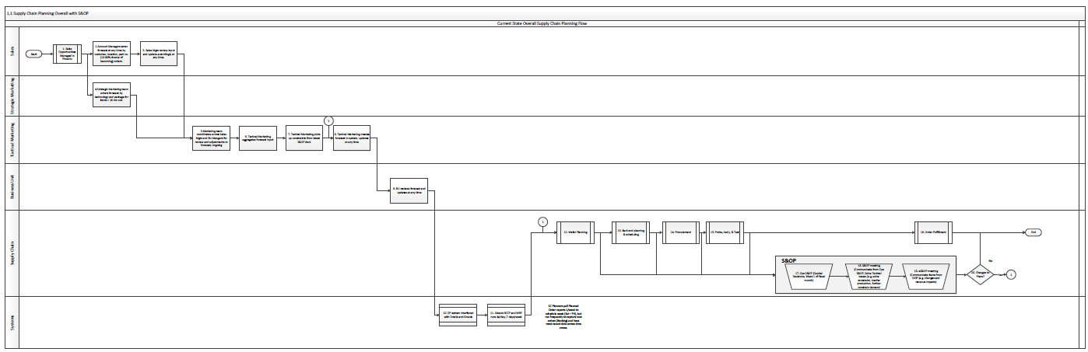
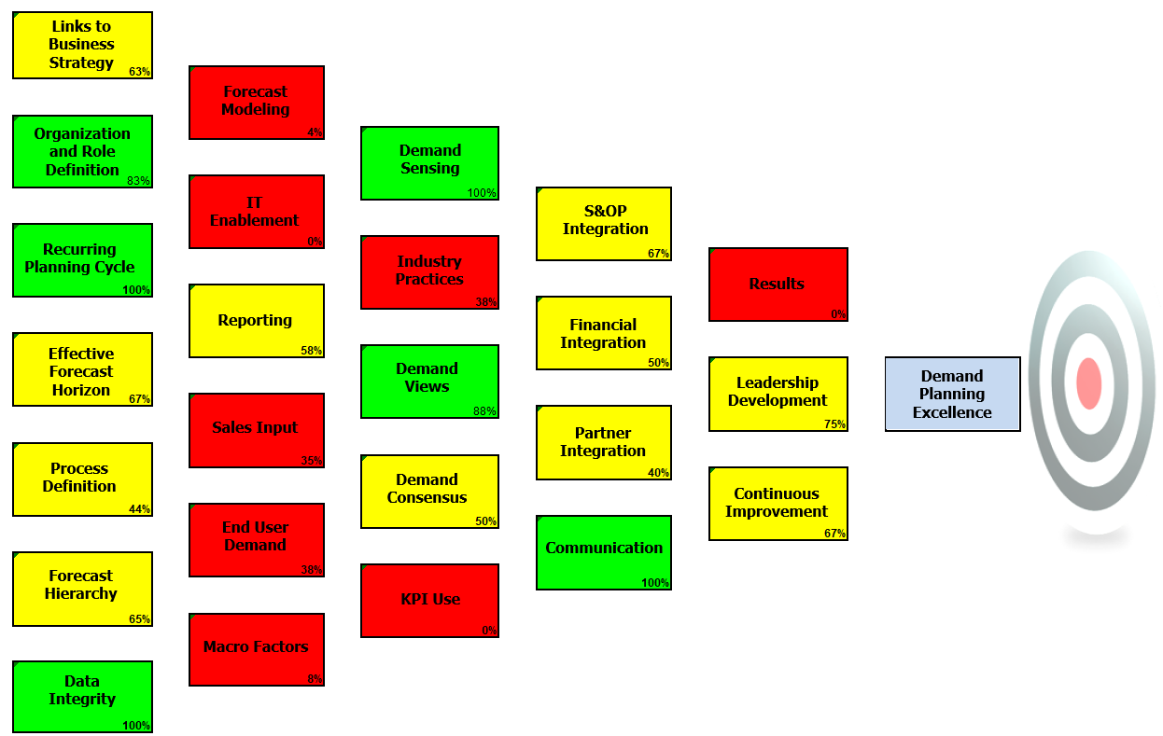
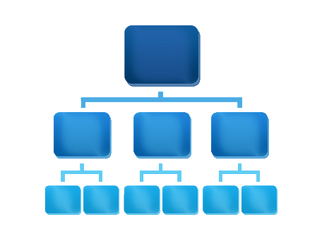

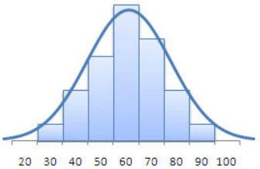

Assessments have several components
Leadership Interviews
IT Evaluation
Process Workshops and Critique
Best Practice Tools*
Org
Review
Assessment
Findings
Meeting Evaluations
Report Evaluations
*Nexview uses comprehensive best practice evaluation tools for S&OP/IBP and the planning processes below the S&OP layer
Targeted data review/analysis for benefit development
© Nexview Consulting, LLC ®

Slide 11
We often use a prioritization matrix when working with clients to design projects
SAMPLE
HIGH
Margin Improvement
S&OP Improvement
Demand Manager Role
Customer Segmentation
Improve MTO/MTS inventory strategy
IMPLEMENT
KPI Effectiveness
Financial Integration
Demand Planning Tool
Improve Demand Planning
Roles & Responsibility Definition
Product Portfolio Management
PROBABLY
Automate S&OP Reports
Lead Time Management
Improved Production & Inventory Planning
Effect on the Organization
Consolidate Stock points Across Facilities
Active Management of “At Risk” Inventory
MAYBE
Premium Freight Rules and Better Planning Overall
CHALLENGE
LOW
11
LOW
Effort to Implement
HIGH
© Nexview Consulting, LLC ®

Slide 12
A process model can help you define and communicate your functional scope as well as priorities and progress
SAMPLE
We start with the SCOR* model, then tailor it to the appropriate scope and client need.
*Supply Chain Operations Reference
© Nexview Consulting, LLC ®

Slide 13
You might consider studies/examinations of these areas throughout the supply chain
Product
Management
Customer
Management
Demand
Planning
Supply
Planning
Procurement
Distribution &
Logistics
Product development/ stage gate process
Sales & Product Profitability analysis
Integration with supply chain (e.g. Portfolio Review)
Product lifecycle management
Customer and product sales analysis
Profitability
Segmentation
Service levels by segment and promises based on capabilities
Customer complaints
Order fulfillment and OTIF performance
Demand predictability
Forecast error and impacts
Links to Business Forecasting
Process and Tools
Longer-term production/capacity planning
Production schedule stability
Production schedule adherence
Changeovers and sequence
Make-to-Order vs. Make-to-Forecast
MRP and raw material planning
Process and Tools
Spend analysis
MRO inventory and spend
Supplier base rationalization
Process and Tools
Planning interface and RM inventory management
Supplier lead time management
Supplier perf. Management
Warehousing
Inventory management
Order fulfillment
Freight management
Outsourcing options
Network optimization
Process and Tools
Sales & Operations Planning (Process and effectiveness)
Organization Effectiveness (Roles/responsibilities, structure, span of control)
Information Systems (Use for process enablement)
Management System (Linkages top to bottom and across the supply chain)

Slide 14
Results are hard to identify, agree, and measure – but if you don’t do it, your project will just be another good idea…and opinions on its priority will vary
SAMPLE
BENEFIT AREA | BASELINE | IMPROVEMENT TARGET LOW | IMPROVEMENT TARGET HIGH | LOW P&L ($MM) | HIGH P&L ($MM) | OPERATING LEVERS
Product Rationalization/Margin improvement | 40% gross margin, company target is 48%) | 44% | 48% | 2 | 4 | Replace low margin products with higher margin products Product rationalization (low volume/low margin) Pricing Portfolio Review component of S&OP
Premium Freight | 18% of Total Freight Spend | 16% of Total Freight Spend | 12% of Total Freight Spend | 0.5 | 1 | Supply chain optimization Sales & Operations Execution (S&OE) Customer segmentation Business rules Management system including KPI visibility
Lead Time Improvement (assumes capacity remains sold out) | 24 weeks | 2 weeks | 4 weeks | 3.5 | 5 | Improved lead time visibility and update based on regularly measured actuals Supply chain optimization (inventory, product rationalization, demand planning) Manufacturing throughput improvement due to more stable schedule (improved S&OE) and operational improvements in progress
TOTAL |  |  |  | 6.0 | 10.0 | These are annually recurring benefits
© Nexview Consulting, LLC ®

Slide 15
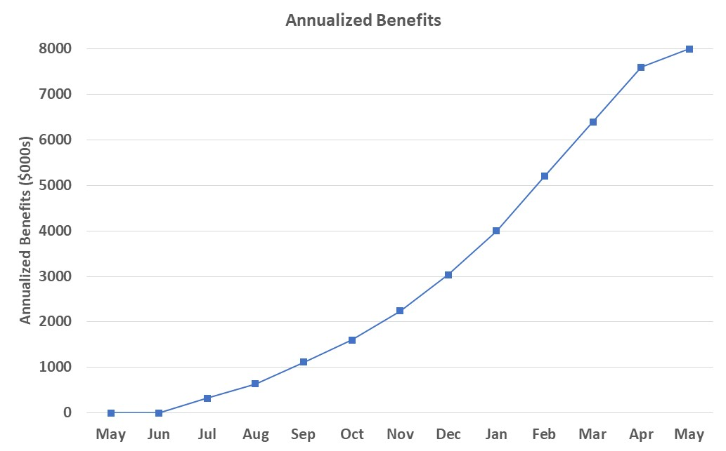
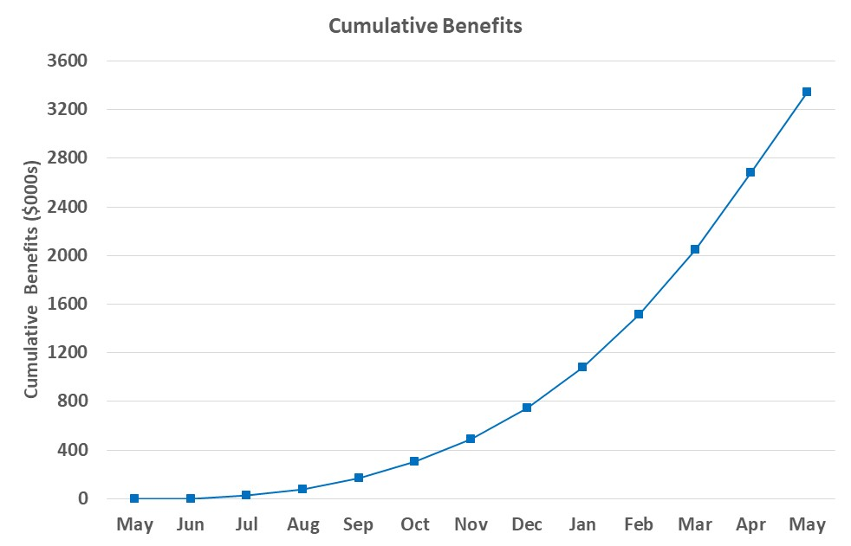
In addition to identifying the benefit areas and the amounts, the timing needs to be determined in conjunction with milestone achievement on the implementation plan
SAMPLE
Annualized Benefits – What we get on an annually recurring basis at each month in the project. Annualized benefits ramp-up as project milestones are completed until they reach the full benefit achievable.
Cumulative Benefits – The cumulative monthly total of actual benefits we achieve each month. Cumulative benefits build into the future at the monthly run rate once full run rate is achieved.
Full annual run rate = $8M
Now get $667K/mo ($8M/year)
Short Interval Control on tactical areas and other quick wins (less of a slope)
Y/E cumulative benefit = $747K
Process and other improvements kick-in
Notes
Once we have this, we can calculate other project metrics such as payback timing, NPV, and ROI
Most improvement efforts don’t show measurable results; it’s very rare that we see a client that can pull off a measurement system without our guidance on mechanics and change management
© Nexview Consulting, LLC ®

Slide 16
We use this slide to illustrate the interconnections and dependencies. The point is we need all the parts to make the whole work.
This is a common flow for manufacturing firms, this should be tailored to your application.
Product Portfolio Review(s)
Demand Review(s)
Supply Review(s)
Pre-S&OP & Executive S&OP
S&OP
(Aggregate)
Unconfirmed plans flow up
Decisions and updates flow down and to the right
Supporting Processes
(SKU Detail)
Product Portfolio Management
Demand Planning
Supply Planning
Budgeting & Financial Integration throughout
Constraints, Issues, Decisions
Plans are confirmed in respective S&OP component meeting
Portfolio Mgmt
New Product Demand/ Phase out
Statistical Base
Sales input
Supply Planning
Capacity Planning
S&OP will build capabilities to manage and execute at all levels
Profitability & Pricing
Innovation/ Agile/Stage Gate
Macro/ Market Effects
Demand Function Recommen-dation
MRP & Procurement
MTO/MTS and Inventory
Tactical Execution
(SKU Detail)
Product Trials
Pricing Management
Order Mgmt
Scheduling
Production
Service Level Rule Adherence
NPD Project Mgmt
Short-term Demand Changes
Quality Mgmt
Procurement Transactions
Disruptions are variances to plan
© Nexview Consulting, LLC ®

Slide 17
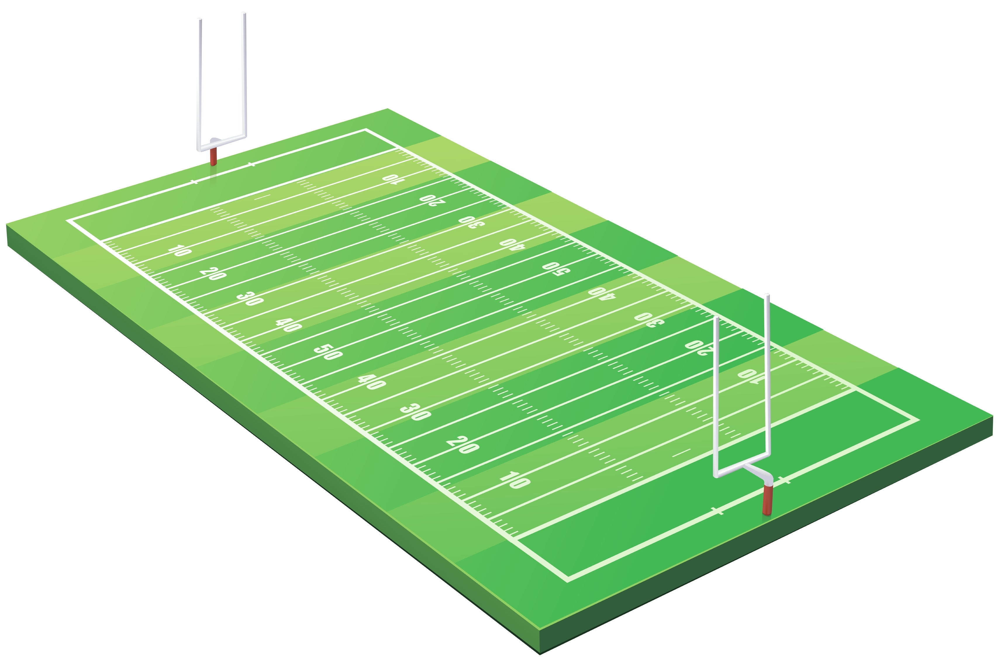






This may help you illustrate how functions have their own priorities and how S&OP is the coach that brings them together
See an executive S&OP overview of key elements, most processes have gaps in areas described in the link.
Sales
Market pulse and voice of the customer
Competition
Everything for every customer, avoid “no”
Volume growth and market share
The best products with many options and customization
Flexibility to meet uncertain demand
Infinite inventory, no lead time, no constraints
Speed and control averse
Operations
Unit cost, efficiency
Standardization
High volume/long runs
Predictability
Constraint management
Quality, safety, reliability
Simplicity
S&OP
Product Development
Technology
Performance
Features
Quality
Product variants
Complexity
Finance
Profitable growth
Cost management
Reliance on history
Performance to budget
Controls
Risk management
Skepticism and caution on new things
Year-end focus
Supply Chain
On-time-in-full
Information and product flow across parties (the chain)
Linkages and constraints
Manageable changes
Customer and service segmentation
Adequate planning horizon
Cost and right-sized inventory

Slide 18
A system of KPIs is used throughout S&OP and fit for the level of the audience
Integ Operating Review and/or Executive S&OP
SPEED
FLEXIBILITY
RELIABILITY
TOTAL COST
NPD
Volume
and $
Margin
Forecast
Error
Inventory
DOH
Budget
Comparison
BU or Enterprise Level KPIs
New Prod
Intro Cycle
Time
OTIF
Capacity
Utilization
Inventory $
Off-spec
Product
Product Family, Regional, Plant Level
Portfolio Review
Demand Review
Supply Review
NPD Volume
and $
At Risk
Inventory $
Forecast
Error
Forecast
Stability
Capacity
Utilization
Inventory
DOH
Prod Plan
Adherence
Lead Times
New Prod
Intro Cycle
Time
Budget
Comparison
Forecast
Bias
Budget
Comparison
Budget
Comparison
Inventory $
Distribution
Costs
Especially for Executive S&OP, the KPI scorecard can be integrated with financial metrics for the “Balanced Scorecard” approach.

Slide 19
Here’s a listing of a few of the foundational process elements you might look for
Product Portfolio Management | Current State
New products are introduced and taken out of the supply chain through a structured process.
New product demand is separated from existing products and ramp-up is planned over the planning horizon.
The portfolio is analyzed on regular intervals to determine where each product is in its lifecycle.
Product margins are understood, reviewed regularly, and plans made to maintain target margin at the product and portfolio levels, and appropriate action is taken when needed.
Products are removed from the portfolio, not only added.
Near obsolete/at-risk inventory is managed with supply chain to avoid a total loss.
Portfolio KPIs are in place and managed.
The above is managed through the Product Portfolio Review component of S&OP.
Adequate
Partial
Missing
© Nexview Consulting, LLC ®

Slide 20
Here’s a listing of a few of the foundational process elements you might look for (cont’d)
Demand Planning/Management | Current State
There is a defined role for demand planning.
Demand planning has independence from Sales/Commercial.
There is a tiered demand planning process that consists of commercial input, aggregation across the business, analysis, review, recommendation, and consensus over the planning horizon.
Roles and responsibilities are clear and integrated with a defined calendar and rolling planning horizon.
The demand plan is used to generate the rolling financial plan.
Statistical analysis supports other input for predictable items and there are rules for use of statistical analysis.
Demand planning KPIs are in place and managed effectively.
The Demand Plan for and from Demand Review is unconstrained, and is later constrained through subsequent meetings in the S&OP cadence.
Major process components and overall maturity is consistent across business units.
There is a commercial demand planning system in place that is integrated with the rest of supply chain planning.
The above is managed through the Demand Review(s) component of S&OP.
Adequate
Partial
Missing
© Nexview Consulting, LLC ®

Slide 21
Here’s a listing of a few of the foundational process elements you might look for (cont’d)
Supply Planning/Management | Current State
The physical configuration of supply assets and strategy can be linked to the business strategy.
Product flows are mapped logically from the operational strategy.
There is a digital twin/optimization model of the operational assets that support operational strategy decisions.
There is a longer-term supply and capacity planning process that supports S&OP and longer-term operational planning, and the process considers a holistic viewpoint across facilities.
Longer-term capacity planning and production scheduling processes are distinct and the hand-off is clear.
Production scheduling processes across facilities, may not be different to suit differing needs, but the maturity is common and common tools are used where practical.
Reasons behind schedule changes are understood and managed cross-functionally.
Lead times for all items are defined, maintained, and followed in planning.
Make-to-order/Make-to-stock/Finish-to-order is defined for all items and there is a model to support decision making.
Inventory planning extends over the S&OP rolling horizon and is supported by statistical analysis.
Supply planning KPIs are in place and managed.
The Supply Plan is managed in the Supply Review component(s) of S&OP and rolls up appropriately through Executive S&OP.
Adequate
Partial
Missing
© Nexview Consulting, LLC ®

Slide 22
Here’s a listing of a few of the foundational process elements you might look for (cont’d)
Customer and Order Management – Supply Chain Viewpoint | Current State
Customers have been segmented, service levels have been aligned to each segment, and the rules are followed.
Premium freight decisions are rule-based and it’s clear who makes decisions.
Lead times are defined, understood, and respected in the ordering process.
Inventory availability is visible and accurate.
There is a site level weekly/tactical process and meeting for coordinating orders, production schedule, and shipping that also manages exceptions/expedited events (Sales & Operations Execution).
The S&OE process is consistent across sites.
On-time-in-full (OTIF) is clearly defined, regularly managed, and reason codes are recorded for exception and root cause management.
The OTIF metric contains the components of shipping date, quantity, and carrier delivery date.
OTIF is managed cross-functionally and at the right levels in S&OP to be able to address root causes.
There is clear delineation between what sales does and what customer service does.
Sales has visibility into order status to avoid non-value-added and repetitive inquires and requests.
Adequate
Partial
Missing
© Nexview Consulting, LLC ®

Slide 23
Here’s a listing of a few of the foundational process elements you might look for (cont’d)
Procurement | Current State
There is a defined strategic sourcing plan (written out) that describes how sourcing strategies link to the business strategy.
There is a defined and implemented strategy that defines the level of centralization versus decentralization to meet the needs of the business.
Supplier alliances are in place where it is appropriate and rogue spending is managed.
Vendor Managed Inventory practices are in place where appropriate.
Collaborative Planning, Forecasting, and Replenishment practices are in place where appropriate.
A supplier approval and management program is in place.
Items are organized in commodity categories that are analyzed on a regular basis for suppliers, price variances, and savings (potentially shared savings) opportunities.
Buyers are organized around commodity categories.
IT systems have eliminated manual process steps.
Spending approval authorizations have been defined throughout the organization.
There is a process for efficiently dealing with small amount purchases (e.g., p-cards).
The PO process has eliminated inefficiencies.
There is a robust KPI and management system to manage KPI performance.
Adequate
Partial
Missing
© Nexview Consulting, LLC ®

Slide 24
Here’s a listing of a few of the foundational process elements you might look for (cont’d)
Sales & Operations Planning/Integrated Business Planning | Current State
There is a monthly cadence and calendar for a set of integrated S&OP meetings.
There is a constant rolling planning horizon that covers the longest lead time item, is sufficient for intermediate-term supply and capital planning, as well as financial planning.
There is a defined near-term frozen period that is not discussed in the S&OP meetings.
Discussion starts at the product family level, then rolls up to the business unit and enterprise levels as the meetings involve higher management levels.
Each component in the S&OP cadence of meetings has a single sponsor who also owns the output plan and corresponding results.
Each component meeting has a facilitator that owns the underlying more detailed planning process.
There is a system of layered KPIs throughout the meeting cadence with clearly defined accountabilities.
S&OP has management team participation and is the process by which the significant business decisions are made.
S&OP plans are both volume and monetized such that financial forecasting is derived from the volume plans.
The S&OP plan is the plan of record that all in the organization use and commit to.
There is no confusion in the organization between a leadership S&OP process and tactical, detailed demand/supply discussions that occur primarily manager levels.
S&OP is a process that builds teamwork across functions, involves leadership as well as developing leaders, is the platform for continuous improvement, and is showing results for the business.
See an executive S&OP overview of key elements, most processes have gaps in areas described in the link.
Missing
Adequate
Partial
© Nexview Consulting, LLC ®

Slide 25
Over the last 20 years, the trend has been to consolidate supply chain functions under a single org structure
While there’s usually more than one way to do this, we still regularly see awkward and fragmented structures.
Supply Chain Executive
Analytic, Process Standardization, Project Roles
Demand Planning¹
Supply Planning
Procurement
Customer Service²
Distribution & Logistics
A World Class Supply Chain Organization:
Is built around the process - start to finish
Is structured to ensure consistency across the enterprise
Separates planning from tactical execution
Covers areas that have been recognized as being part of the field over the last few decades
Can be lined up with the S&OP meeting flow
A
Notes:
Has migrated from Sales to remain independent and tight integration with supply planning
Has often migrated from Sales to Supply Chain due to heavy supply chain related tasks of order management and supply chain commitments
Usually owned by a Commercial/Product Management group but Demand Management is significantly involved
A
Portfolio
Review³
Demand
Review
Supply
Review
Pre-S&OP
Exec S&OP
S&OP Meeting Flow
Planning
Execution

Slide 26
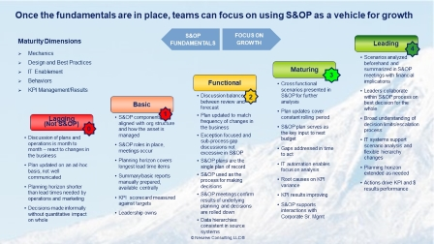
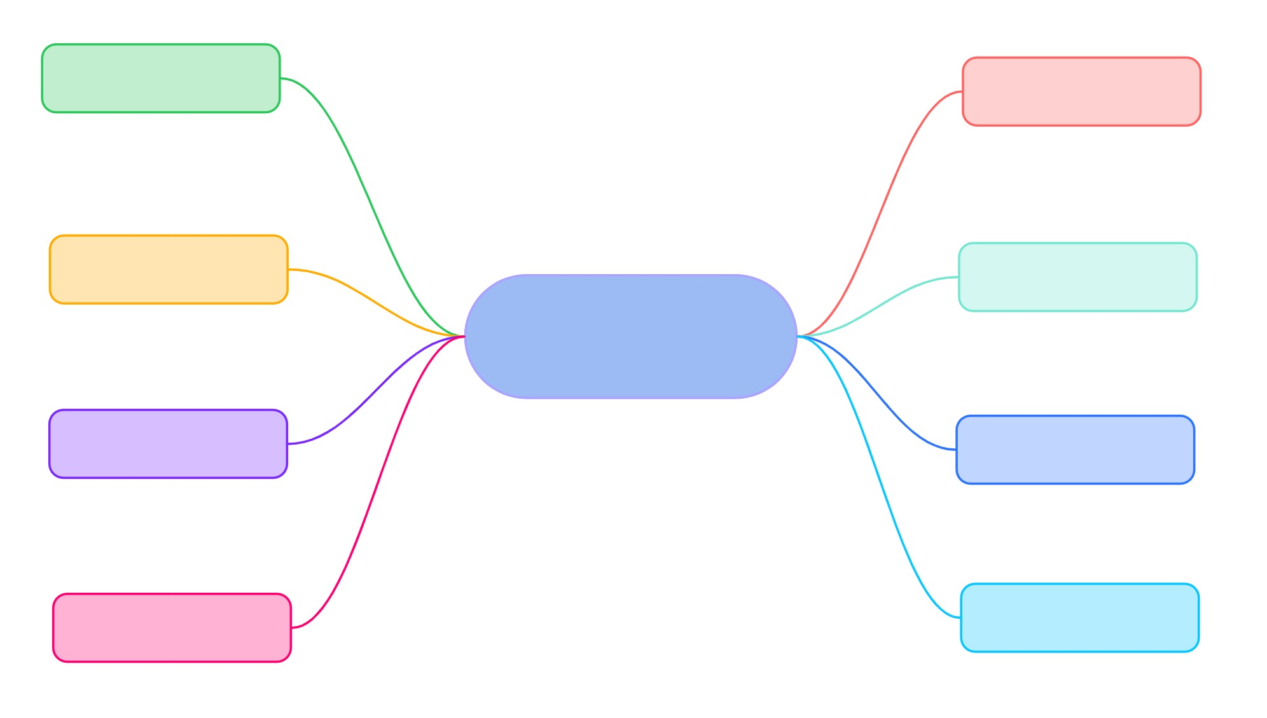

Here’s a few other things that may help
Click the graphics in slide show mode for the link to work.
Org Considerations for Supply Chain and RACI Across Interfacing Functions
S&OP Maturity Model
Mind map/Root Causes Diagram for Low OTIF
Key Components of Change Programs
This will help explain the components and dependencies to others.
© Nexview Consulting, LLC ®

Slide 27
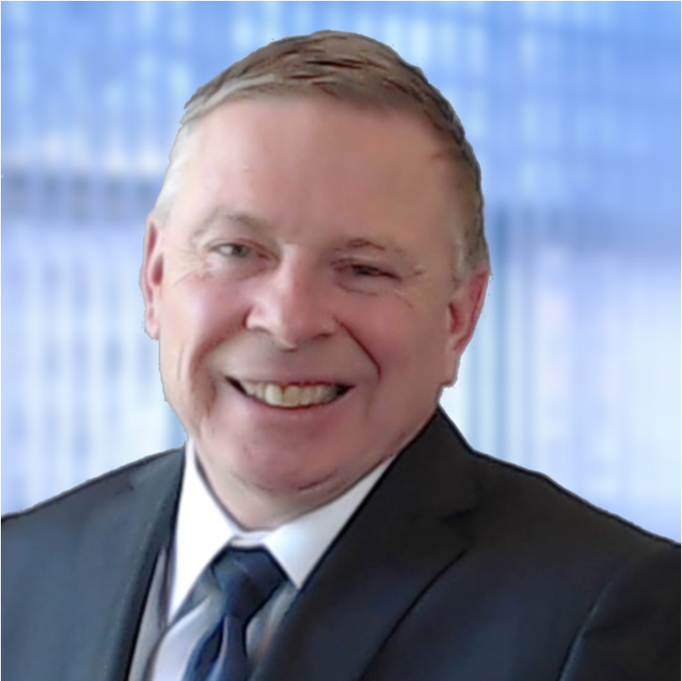





Nexview specializes in S&OP and Supply Chain improvement led by our Principals
Nexview Consulting
Summary
25+ years in management consulting
Leader of large-scale change projects for global corporations, benefits > $500MM
Consulted and taught S&OP, and supply chain across five continents
Author – Sales & Operations Planning RESULTS; S&OP Jumpstart!
Prior Leadership Roles
Celerant Consulting, Deloitte & Touche, Plan4Demand, Hughes Aircraft
Qualifications
MBA, University of Southern California
MS, Mechanical Engineering, California State University-Northridge
BS, Aerospace Engineering, Syracuse University
Certified Public Accountant, Six-Sigma Blackbelt
FIRM
Founded in 2009, with offices in the Boston metro area
3 Partners plus a network of senior colleagues developed over the past 25+ years
S&OP and supply chain consulting
Training and coaching
Organization design & development
Leverage leading edge technology solutions
Growing on-line models through Nexview Online
Proven track record in S&OP and integrated supply chain optimization
Recognized thought leadership in the marketplace
Clients are served by the Principals and experienced consulting/industry leaders only
More than just SMEs – emphasize performance improvement, results management, behavior change, leadership development
Eric J. Tinker
Managing Principal
SERVICES
Summary
30+ years supporting mid-market, global, and private equity companies across geographies
Subject matter expertise in supply chain, working capital optimization, product portfolio, procurement, and associated technologies
Differentiated expertise in development of analytical tools to support improvements
Prior Leadership Roles
Highland Group, Maine Pointe, Brooks International, BDO Seidman, PeopleSoft
Qualifications
MBA, University of Dallas
Bachelor of Commerce, University of Toronto
Joseph J. Cardoni
Principal
DIFFERENTIATORS
Summary
25+ years in industry and management consulting
Versatile leader with differentiating expertise in S&OP and logistics
Industry background in energy, retail, manufacturing, distribution
Prior Leadership Roles
MTG, Corven, Denali Group, Tenzing, BOC Gasses, NuCO2
Qualifications
MBA, New York University
BS, Business, Purdue University
Jon P. Gilbert
Principal

Slide 28


Why Nexview?
Results focus, $500M+ in benefits delivered for clients thus far and looking for more
You get the firm leadership to work on your project
We are senior level consulting leaders who have led integrated change projects all over the world, but we’re hands on, and offer detailed experience and success in implementing S&OP and supply chain improvement
Strong global experience with partners and network of experienced consultants from larger consulting firms and industry
Emphasize ownership with your people, behavior change, results, and change management along with the technical/best practice elements of our work
Flexible service model to provide the level of service appropriate for your situation with no internal distractions
Recognized thought leadership across several continents with visible contributions in the media
Our values are:
Optimism
Collaboration
Confidence
Resourcefulness
Candor
Results
12

Slide 29










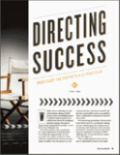

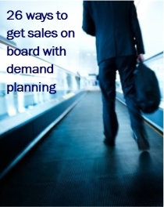
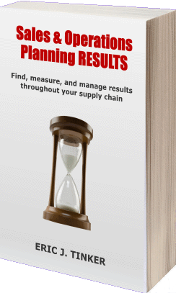
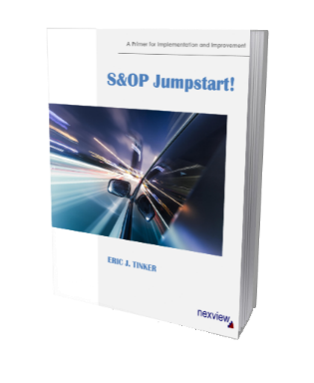
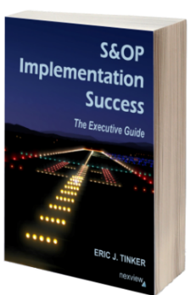
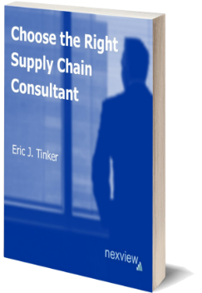
We invite you to see our extensive content archive on the website and join our community on Nexview Online
Blog Posts
Articles
eBooks
Benchmarking
Surveys
Conference
Presentations
Videos
Tools & Templates
Here are some additional items that may help you
“Revitalize Your S&OP”
Journal of Business Forecasting
“Directing Success –
10 Tips for S&OP Sponsors”
APICS Magazine
“Why S&OP Matters to the CFO”
Journal of
Trading Partner Practices
“26 Ways to Get Sales On Board
with Demand Planning”
Supply Chain Quarterly
Sales & Operations Planning RESULTS
Full book on Amazon.com
S&OP Jumpstart! A Primer for Implementation and Improvement
Booklet for project teams, See on Amazon.com
S&OP Implementation Success
eBook pre-release of next full book, Our implementation methodology and tips
Choose the Right Supply Chain Consultant
eBook, An insider’s candid perspective
13

Slide 30




About Nexview Consulting
Nexview Consulting is a boutique management consulting firm that specializes in Sales & Operations Planning and Supply Chain improvement. We leverage S&OP to be the platform for continuous improvement and profitability in client organizations. We also work with clients to improve organizational performance, structure, and enabling supply chain technology.
Consulting methods promote sustainability of performance improving behaviors, tangible results, and development of client team members. Our consultants are highly-experienced business and consulting leaders with track records of delivering results for clients across the world, typically with larger more well-known consulting firms. We are based in the Boston area, but we travel worldwide to conduct training seminars, speak at conferences, and work with clients on high-impact, performance improving initiatives.
Nexview Consulting, LLC
info@nexviewconsulting.com
+1.800.631.4842
15 Constitution Drive, Suite 1A
Bedford, NH 03110 USA
nexviewconsulting.com
14

